Slide 1
DBMS Presentation
Prepared By Sumon Karmakar

Slide 2
DBMS Presentation
Database is a collection of related data and data is a collection of facts and figures that can be processed to produce information.
A DataBase Management System(DBMS) stores data in such a way that it becomes easier to retrieve, manipulate, and produce information.

Slide 3
DBMS Presentation
Characteristics of DBMS:- There are different characteristics of DBMS. They are as follows:-
Real World Entity
Relation Based Tables
Isolation of Data and Application
Less Redundancy
Consistency
ACID Property

Slide 4
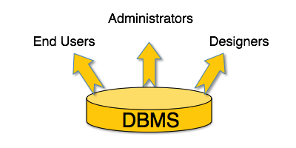
DBMS Presentation
Users of DBMS:- There are different types of users who can use the Database. They are Administrators, Designers, and End Users.

Slide 5
DBMS Presentation
Architecture of DBMS:- There are there typed of tire by which a user can access a database. They are
Single tier architecture
Two tier architecture
Three tier architecture

Slide 6
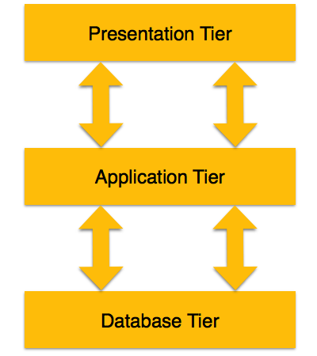
DBMS Presentation
Three tier Architecture of DBMS:-

Slide 7
DBMS Presentation
Three tier Architecture of DBMS:-
Database(Data) Tier
Application(Middle) Tier
User(Presentation) Tier

Slide 8
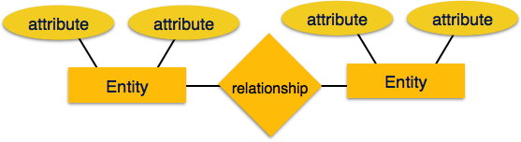
DBMS Presentation
Entity Relationship Model(ER Model):- Entity-Relationship (ER) Model is based on the notion of real-world entities and relationships among them. While formulating real-world scenario into the database model, the ER Model creates entity set, relationship set, general attributes and constraints.
ER Model is best used for the conceptual design of a database.
ER Model is based on −
Entities and their attributes.
Relationships among entities.

Slide 9
DBMS Presentation
Entity Relationship Model(ER Model):-
Entity:- An entity in an ER Model is a real-world entity having properties called attributes. Every attribute is defined by its set of values called domain.
RelationShip:- The logical association among entities is called relationship. Relationships are mapped with entities in various ways. Mapping cardinalities define the number of association between two entities.
Mapping cardinalities −
one to one
one to many
many to one
many to many

Slide 10
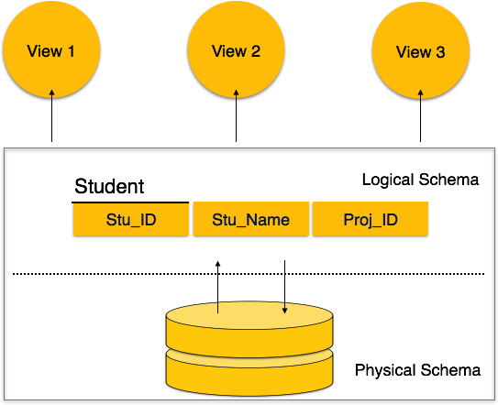
DBMS Presentation
Database Schema:- A database schema is the skeleton structure that represents the logical view of the entire database. It defines how the data is organized and how the relations among them are associated. It formulates all the constraints that are to be applied on the data.

Slide 11
DBMS Presentation
Database Schema:- DataBase Schema can be divided into two parts.
Physical Schema
Logical Schema

Slide 12
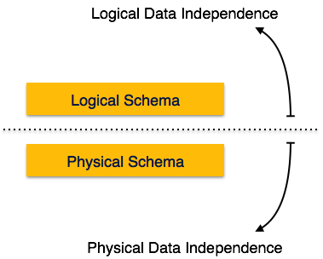
DBMS Presentation
Data Independence:-A database system normally contains a lot of data in addition to users’ data. For example, it stores data about data, known as metadata, to locate and retrieve data easily. It is rather difficult to modify or update a set of metadata once it is stored in the database. But as a DBMS expands, it needs to change over time to satisfy the requirements of the users. If the entire data is dependent, it would become a tedious and highly complex job.

Slide 13
DBMS Presentation
Data Independence:- Two Types of Data Independence are there.
Physical Data Independence
Logical Data Independence

Slide 14
DBMS Presentation
Entity:- An entity can be a real-world object, either animate or inanimate, that can be easily identifiable. For example, in a school database, students, teachers, classes, and courses offered can be considered as entities. All these entities have some attributes or properties that give them their identity.

Slide 15
DBMS Presentation
Attribute:- Entities are represented by means of their properties, called attributes. All attributes have values. For example, a student entity may have name, class, and age as attributes.

Slide 16
DBMS Presentation
Types of Attribute:- There are different types of attribute. They are as follows:
Simple Attribute
Composite Attribute
Derived Attribute
Single values Attribute
Multivalued Attribute

Slide 17
DBMS Presentation
Entity Set and Keys:- Key is an attribute or collection of attributes that uniquely identifies an entity among entity set.
For example, the roll_number of a student makes him/her identifiable among students.
Super Key − A set of attributes (one or more) that collectively identifies an entity in an entity set.
Candidate Key − A minimal super key is called a candidate key. An entity set may have more than one candidate key.
Primary Key − A primary key is one of the candidate keys chosen by the database designer to uniquely identify the entity set.

Slide 18
DBMS Presentation
Mapping Cardinality:- Cardinality defines the number of entities in one entity set, which can be associated with the number of entities of other set via relationship set.
Types of Mapping Cardinality:-
One To One
One To Many
Many to One
Many To Many

Slide 19
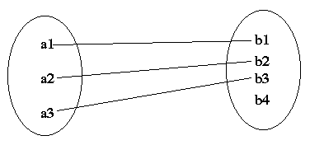
DBMS Presentation
One to One Mapping Cardinality:-

Slide 20
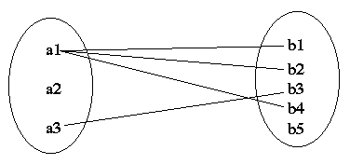
DBMS Presentation
One to Many Mapping Cardinality:-

Slide 21
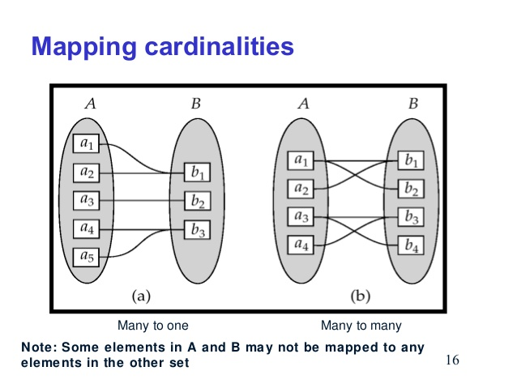
DBMS Presentation
Many to One Mapping Cardinality:-

Slide 22
DBMS Presentation
Many to Many Mapping Cardinality:-

Slide 23
DBMS Presentation
Functional Dependency:- In relational database theory, a functional dependency is a constraint between two sets of attributes in a relation from a database. In other words, functional dependency is a constraint that describes the relationship between attributes in a relation.
Given a relation R, a set of attributes X in R is said to functionally determine another set of attributes Y, also in R, (written X → Y) if, and only if, each X value in R is associated with precisely one Y value in R; R is then said to satisfy the functional dependency X → Y.

Slide 24
DBMS Presentation
Properties of Functional Dependency:-
Given that X, Y, and Z are sets of attributes in a relation R, one can derive several properties of functional dependencies. Among the most important are the following, usually called Armstrong's axioms:^{[3]}
Reflexivity: If Y is a subset of X, then X → Y
Augmentation: If X → Y, then XZ → YZ
Transitivity: If X → Y and Y → Z, then X → Z

Slide 25
DBMS Presentation
Properties of Functional Dependency:-
From these rules, we can derive these secondary rules:^{[3]}
Union: If X → Y and X → Z, then X → YZ
Decomposition: If X → YZ, then X → Y and X → Z
Pseudotransitivity: If X → Y and WY → Z, then WX → Z
The union and decomposition rules can be combined in a logical equivalence stating that X → YZ, holds iff X → Y and X → Z. This is sometimes called the splitting/combining rule.^{[6]}
Another rule that is sometimes handy is:^{[7]}
Composition: If X → Y and Z → W, then XZ → YW

Slide 26
DBMS Presentation
Closure of Functional Dependency:-
The closure is essentially the full set of values that can be determined from a set of known values for a given relationship using its functional dependencies. You use Armstrong's axioms to provide a proof - i.e. Reflexivity, Augmentation, Transitivity.

Slide 27
DBMS Presentation
Armstrong Axioms:-
If F is a set of functional dependencies then the closure of F, denoted as F⁺, is the set of all functional dependencies logically implied by F. Armstrong's Axioms are a set of rules, that when applied repeatedly, generates a closure of functional dependencies.
Reflexive rule − If alpha is a set of attributes and beta is subset of alpha, then alpha holds beta.
Augmentation rule − If a → b holds and y is attribute set, then ay → by also holds. That is adding attributes in dependencies, does not change the basic dependencies.
Transitivity rule − Same as transitive rule in algebra, if a → b holds and b → c holds, then a → c also holds. a → b is called as a functionally that determines b.

Slide 28
DBMS Presentation
Trivial Functional Dependencies:-
Trivial − If a functional dependency (FD) X → Y holds, where Y is a subset of X, then it is called a trivial FD. Trivial FDs always hold.
Non-trivial − If an FD X → Y holds, where Y is not a subset of X, then it is called a non-trivial FD.
Completely non-trivial − If an FD X → Y holds, where x intersect Y = Φ, it is said to be a completely non-trivial FD.

Slide 29
DBMS Presentation
Normalization:-
If a database design is not perfect, it may contain anomalies, which are like a bad dream for any database administrator. Managing a database with anomalies is next to impossible.
Different types of anomalies are
Insertion anomalies
Deletion anomalies
Updation anomalies

Slide 30
DBMS Presentation
First Normal Form(1NF):-
First Normal Form is defined in the definition of relations (tables) itself. This rule defines that all the attributes in a relation must have atomic domains.
As an example we can describe 1st normal form in the following ways:

Slide 31
DBMS Presentation
First Normal Form(1NF):-
Course | Content
Programming | C++,Java
Web | HTML,PHP,ASP

Slide 32
DBMS Presentation
First Normal Form(1NF):- We can now arrange the table in the following manner:
Course | Content
Programming | Java
Programming | Web
Web | HTML
Web | ASP
Web | PHP

Slide 33
DBMS Presentation
Second Normal Form(1NF):- If we want to know about second normal form, we have to understand the following terms:
Prime attribute − An attribute, which is a part of the candidate-key, is known as a prime attribute.
Non-prime attribute − An attribute, which is not a part of the prime-key, is said to be a non-prime attribute.
If we follow second normal form, then every non-prime attribute should be fully functionally dependent on prime key attribute. That is, if X → A holds, then there should not be any proper subset Y of X, for which Y → A also holds true.

Slide 34
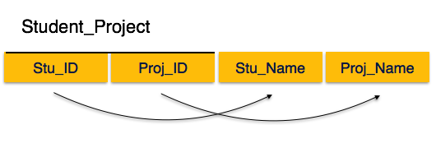
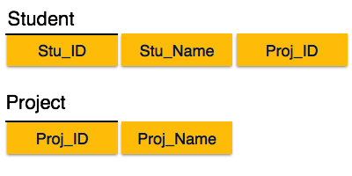
DBMS Presentation
Second Normal Form(2NF):-

Slide 35
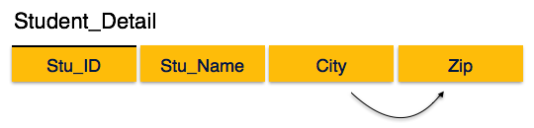
DBMS Presentation
Third Normal Form(3NF):- For a relation to be in Third Normal Form, it must be in Second Normal form and the following must satisfy −
No non-prime attribute is transitively dependent on prime key attribute.
For any non-trivial functional dependency, X → A, then either −
X is a superkey or,
A is prime attribute.

Slide 36
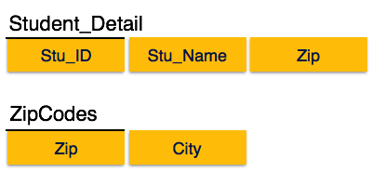
DBMS Presentation
Third Normal Form(3NF):-

Slide 37
DBMS Presentation
Boyce Codd Normal Form(BCNF):- Boyce-Codd Normal Form (BCNF) is an extension of Third Normal Form on strict terms. BCNF states that −
For any non-trivial functional dependency, X → A, X must be a super-key.
In the above image, Stu_ID is the super-key in the relation Student_Detail and Zip is the super-key in the relation ZipCodes. So,
Stu_ID → Stu_Name, Zip
and
Zip → City
Which confirms that both the relations are in BCNF.

Slide 38
Thank You

